Slide 1
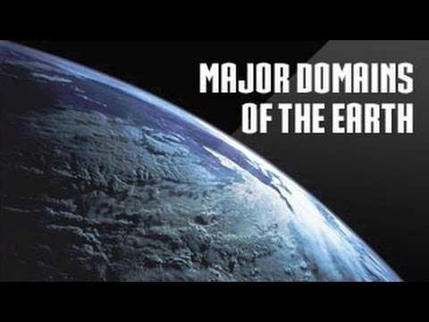
DONE BY STEVE,ADHITHYA,ADARSH.R, GUINDER,SUBHAN AND SUHAIB

Slide 2
INTRODUCTION
Earth is a unique planet in the sense that it has life- supporting system on it which helps in the growth and development of life .These life supporting systems are part of Lithosphere ,Atmosphere ,Hydrosphere and Biosphere.
Lithosphere is the solid in organic portion of the earth which comprises rocks and mineral material. the gaseous envelop surrounding the earth with a gravitational force is known as atmosphere .the sphere which is covered with water is called Hydrosphere. Biosphere is the sum total of all other three spheres.

Slide 3
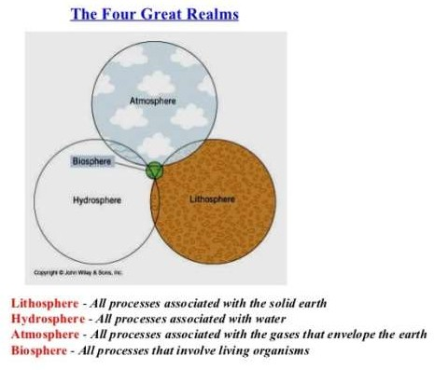

Slide 4
1-LITHOSPHERE
The literal meaning of lithosphere is ‘sphere of rocks’. It is the uppermost layer of rocks which is in organic solid nature and composed of various mineral materials
It includes high mountain ranges like Himalaya in south Asia, Rockies in north America, Andes in South America; Plateaus.
There are seven continents on the earth. Asia is the largest followed by Africa, North America, South America, Antarctica, Europe ,and Australia.

Slide 5
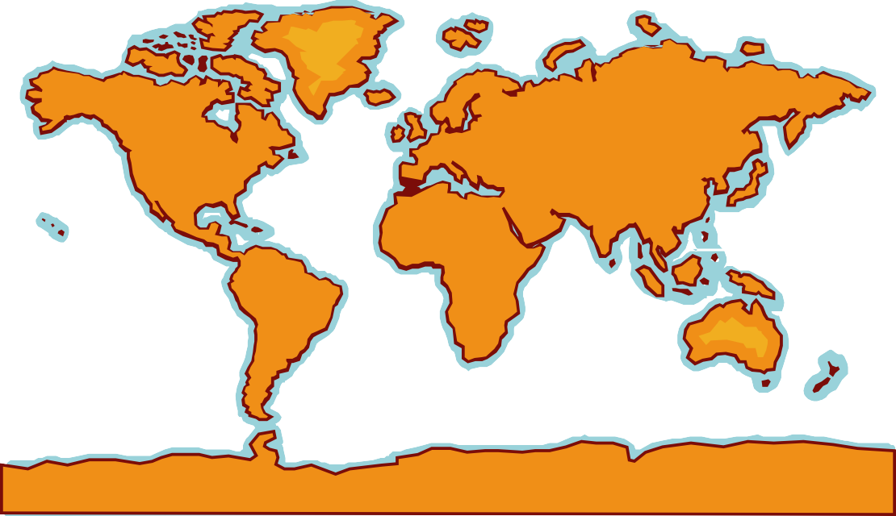
Continents
North America
South America
Europe
Asia
Africa
Australia
Antarctica

Slide 6
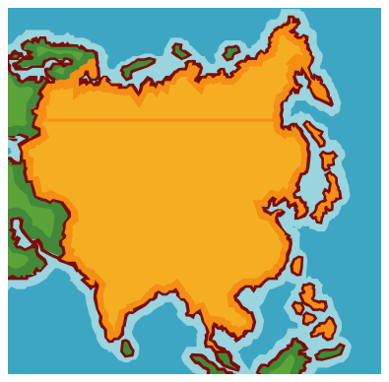
Asia
Asia is the biggest continent, and
it has the most people – it is very
crowded in some parts of Asia!
China is one very big country in Asia
Giant Pandas live in China and eat bamboo
A cool place to visit in Asia is the Great Wall of China – it is the largest structure ever built by man

Slide 7
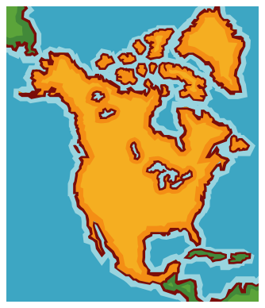
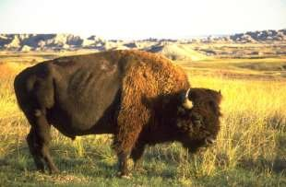
North America
This is the continent we live on
North America is cold in the north and warm in the south
Buffalo live in North America
People in North America came
here from many other continents
The USA, Mexico, and Canada are the three biggest countries in North America

Slide 8
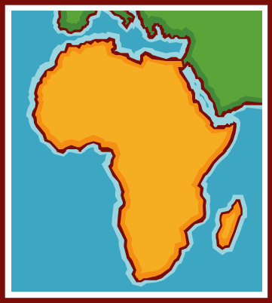
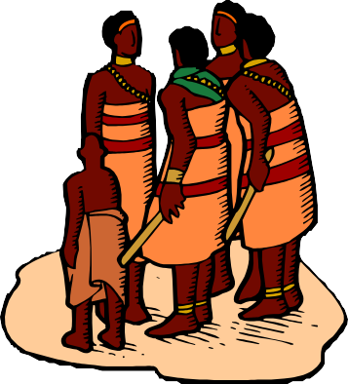
Africa
Africa is a very hot continent because the equator runs through the middle of it
Lions live in Africa
Most people in Africa have dark skin and hair
The Egyptian pyramids are in Africa

Slide 9
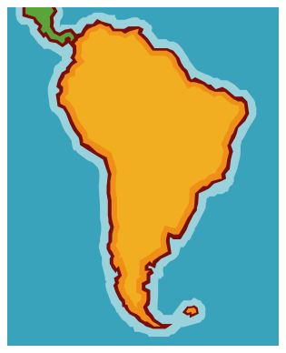

South America
South America is a warm continent
People there speak mostly Spanish
The biggest country is Brazil, where people love to play soccer
The Amazon rainforest is in
South America

Slide 10
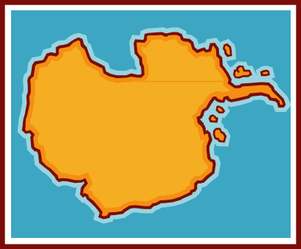
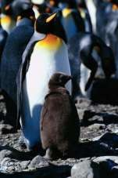
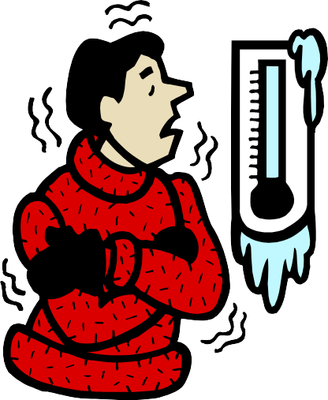
Antarctica
Antarctica is the coldest continent
No people live in Antarctica, but some scientists visit to study the weather or animals there
Many kinds of penguins live in Antarctica

Slide 11
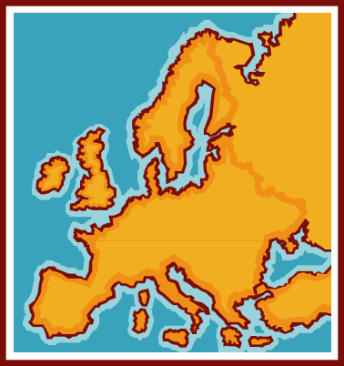
Europe
There are 47 countries in
Europe
People in Europe speak over 50 languages!
The weather in Europe is similar to North America – cold in the north and warm in the south

Slide 12
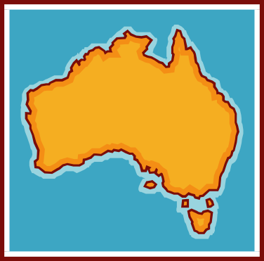
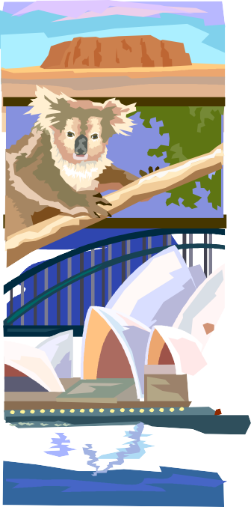




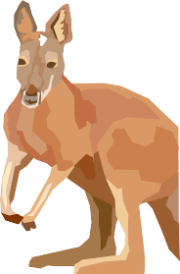
Australia
Australia is an island continent
Native people in Australia are
called Aborigines
Other people in Australia are related to criminals sent from Europe long ago
Kangaroos, koalas, and platypuses
live in Australia
The Great Barrier Reef is in Australia
The weather in Australia is the opposite of our weather

Slide 14
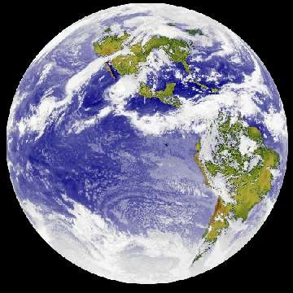
2-Hydrosphere
The hydrosphere is the part of the earth that contains water.

Slide 15
The Structure of Hydrosphere
Oceans—96.5% of water is salt water and it found in the oceans.
Fresh water—the remaining 3 percent is freshwater.
Fresh water distribution:
  Ice: 1.762%
  Groundwater: 1.7%
  Surface Fresh Water: 0.014%
  Atmosphere and soil: 0.002%

Slide 16
Understanding Where Your Water Is Located—Oceans and Ice
What bodies of water hold the largest amount of water?
  Oceans—the largest bodies of water on Earth (contain salt water only)
Examples of oceans:
Atlantic Ocean
Indian Ocean
Pacific Ocean

Slide 17
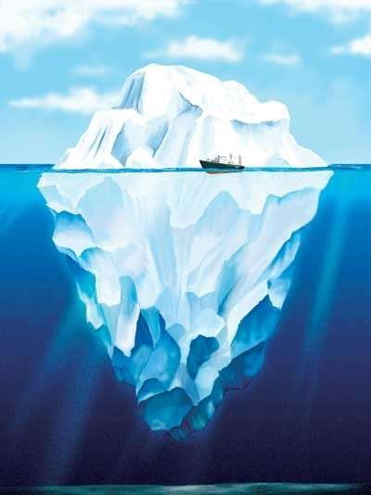
Understanding Where Your Water Is Located—Oceans and Ice
What features house water as ice?
  Icebergs: a large piece of freshwater ice floating in open waters.

Slide 18
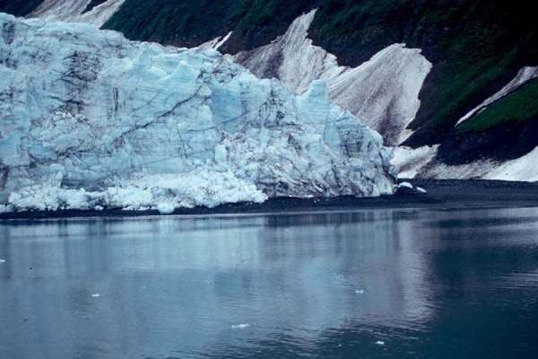
Understanding Where Your Water Is Located—Oceans and Ice
What features house water as ice?
  Glaciers: any large mass of ice that moves slowly over land
  *permanent snow areas also “house” water as ice

Slide 19
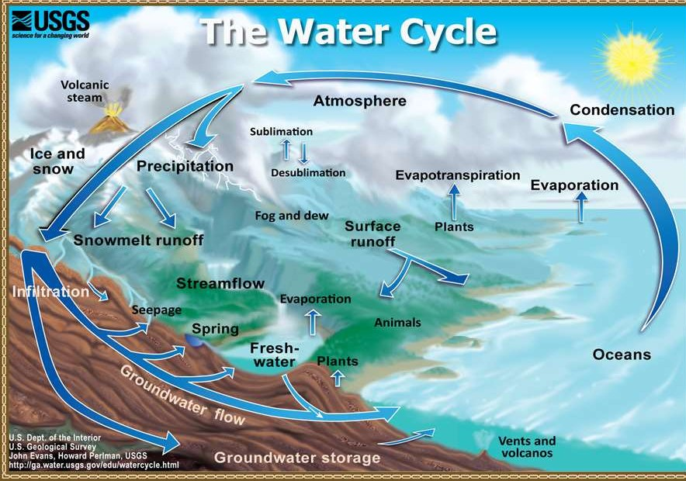

Slide 20
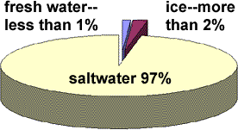

Slide 21
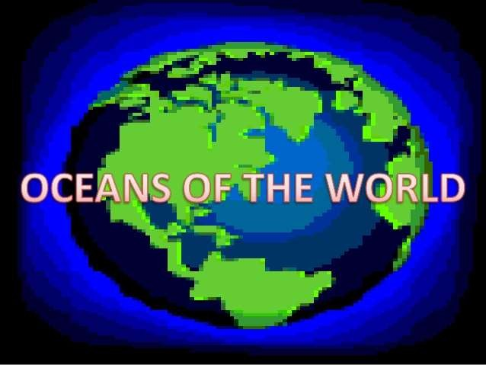

Slide 22
OCEANS
The World’s Oceans
71% of the Earth’s surface is covered by ocean water.
The oceans contain 97% of the earth’s water.
All the oceans and seas are in reality one continuous
body of water.
90% of all volcanic activity occurs in the oceans.

Slide 23
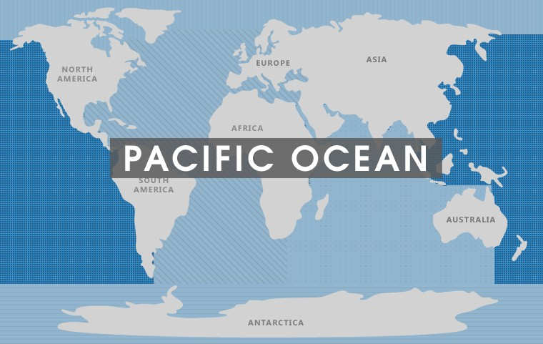

Slide 24
PACIFIC OCEAN
The Pacific Ocean
The Pacific Ocean is the largest of all the oceans.
The area and volume of the Pacific Ocean are greater than the
Atlantic and Indian combined.
• The Mariana Trench in the Pacific ocean is the deepest point in
the world, reaching a depth of 10,911 metres.
• Its name was given by a Portuguese explorer Ferdinand
Magellan , Mar Pacifico in Portuguese, meaning "peaceful sea“.
• The International Date Line passes through the Pacific Ocean

Slide 25
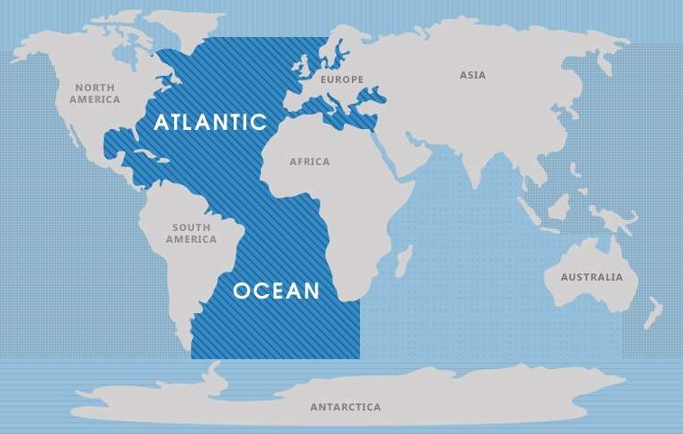

Slide 26
Atlantic Ocean
The Atlantic Ocean
Atlantic Ocean is the second largest ocean in the world. Of all the world's oceans, Atlantic Ocean is the youngest. It is believed to have been formed during the Jurassic
Period. It is one of the busiest sea routes in the Western and Eastern Hemispheres.
The name 'Atlantic' is derived from the legendary island of 'Atlantis', as described by Plato - one of the ancient writers.

Slide 27
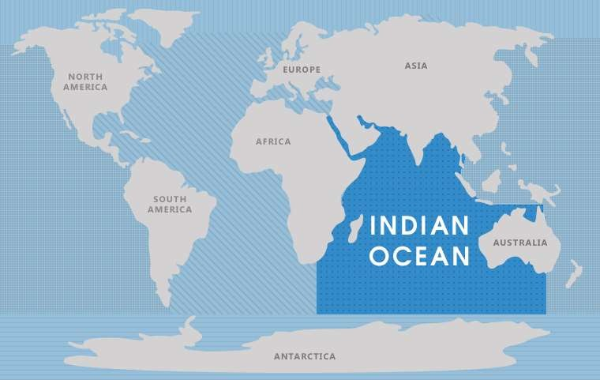

Slide 28
Indian Ocean
The Indian Ocean
Indian Ocean, the third largest saline-water body of the world, derives its
name from India
The only ocean which derives its name from the name of a country.
Indian Ocean is the warmest ocean in the world.
Indian Ocean is known as 'Ratnakara' in the ancient Sanskrit literature.
Ratnakara means 'the maker (creator) of jewels'.
its limited marine animal life which is due to higher water temperature of
this ocean.
Waters in the Indian Ocean have one of the lowest oxygen content of the
world owing to greater evaporation rate in this ocean

Slide 29
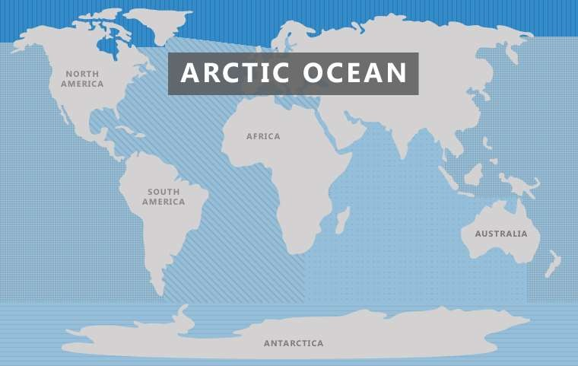

Slide 30
ARTIC OCEAN
The ARTIC OCEAN
The Arctic Ocean is the smallest and shallowest
It is also the coldest of all the oceans.
The north pole is situated in the middle of the Arctic
ocean , there is no land on at the north pole, it is a floating
raft of ice.
Once called the Frozen Ocean, the Arctic Ocean is
covered with ice (2—14 ft/.6—4 m thick) throughout the
year in most of its central and western portions.
The Arctic Ocean is roughly 8% the size of the Pacific
Ocean.
During winter the Arctic Ocean is almost completely
covered in sea ice.

Slide 31
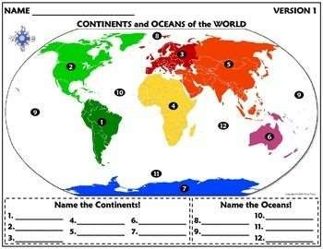
Name the continents and oceans

Slide 32

Introduction to the Atmosphere
The air around us.

Slide 33
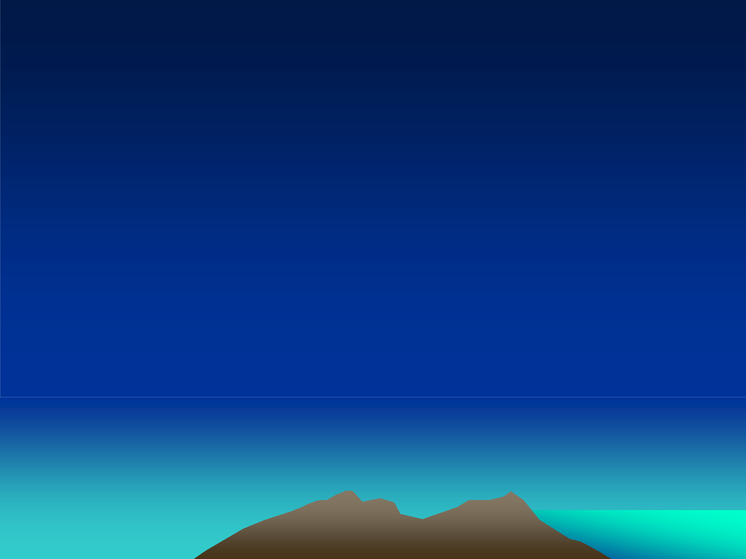

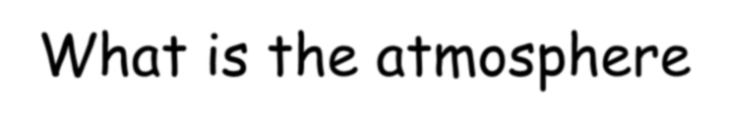

What is the atmosphere?
The Earth is surrounded by a blanket of air, which we call the atmosphere. It reaches over 560 kilometers (348 miles) from the surface of the Earth, so we are only able to see what occurs fairly close to the ground.
This “blanket” moderates temperature, protects us from harmful radiation and supports life.

Slide 34

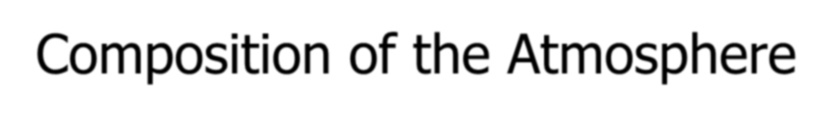




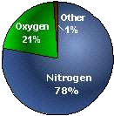
















Composition of the Atmosphere
The present composition of the atmosphere is:
21% OXYGEN (O₂)
78% NITROGEN (N₂)
0.04% CARBON DIOXIDE (CO₂)
~0.9% ARGON (Ar)
Besides water vapor, several
other gases are also present in
much smaller amounts:
Carbon monoxide (formula CO)
Neon (Ne)
Oxides of nitrogen
Methane (CH₄)
Krypton (Kr)

Slide 35
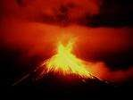
THE FIRST BILLION YEARS
The Earth's surface was originally molten, as it cooled the volcanoes out
gassed out massive amounts of:
CARBON DIOXIDE,
STEAM (H₂O vapor),
AMMONIA and
METHANE.
There was NO
OXYGEN. The STEAM
condensed to form water which then produced shallow seas.

Slide 36
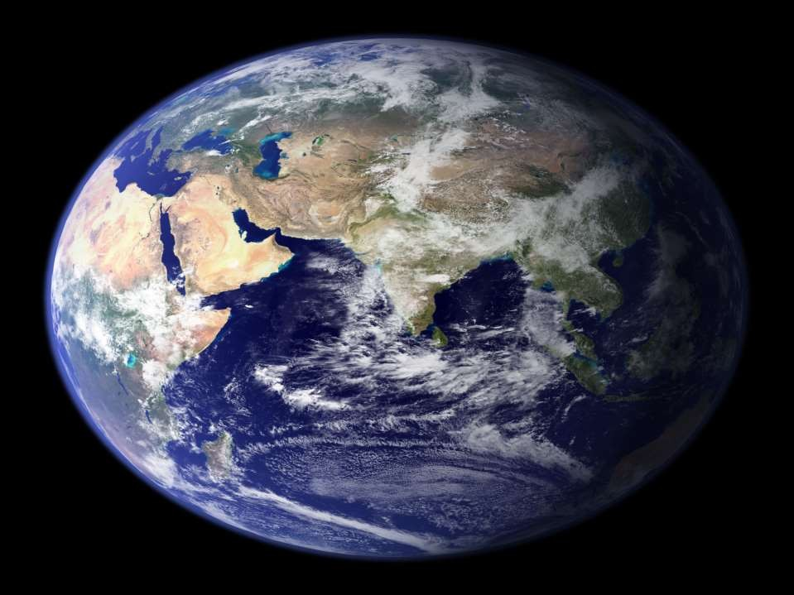
THE BIOSPHERE

Slide 37
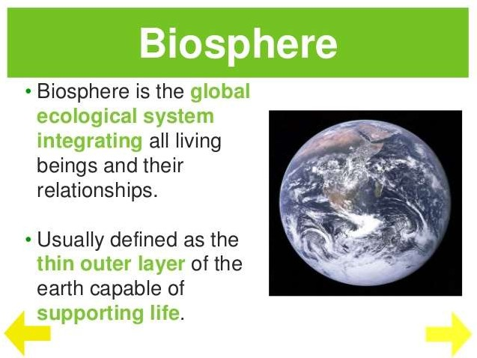

Slide 38
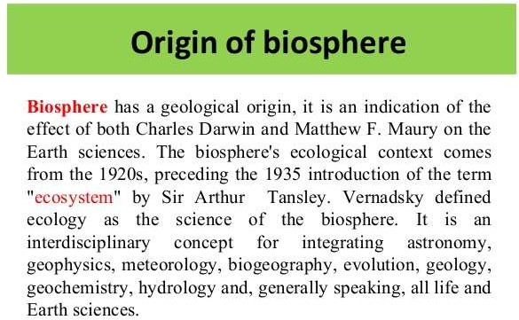

Slide 39


Slide 40



